Slide 1
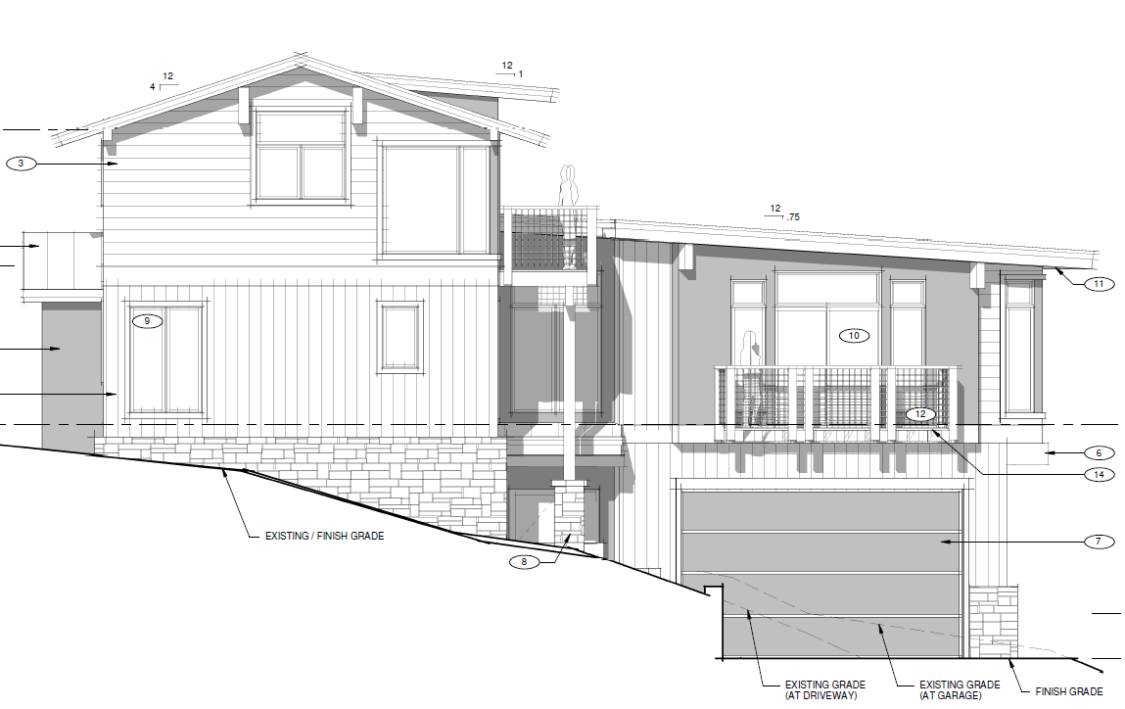
WSUP18-0002 Rutz Residence Grading
Washoe County Board of Adjustment
April 5, 2018

Slide 2
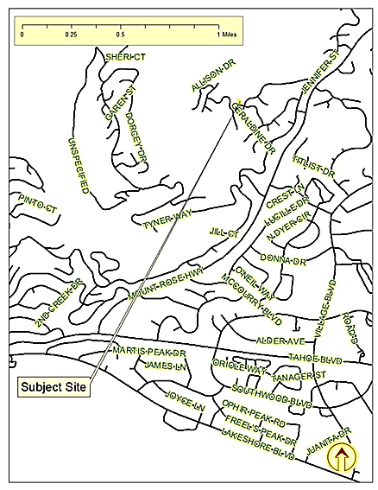
Location
786 Randall Ave

Slide 3
Overview
Major Grading to traverse a slope of 30% or greater
188 Cubic Yards of Excavation
Northwest corner of Randall and Geraldine in Incline Village
Grading proposed only immediately adjacent to driveway
Plans demonstrate general compliance with Development Code standards

Slide 4
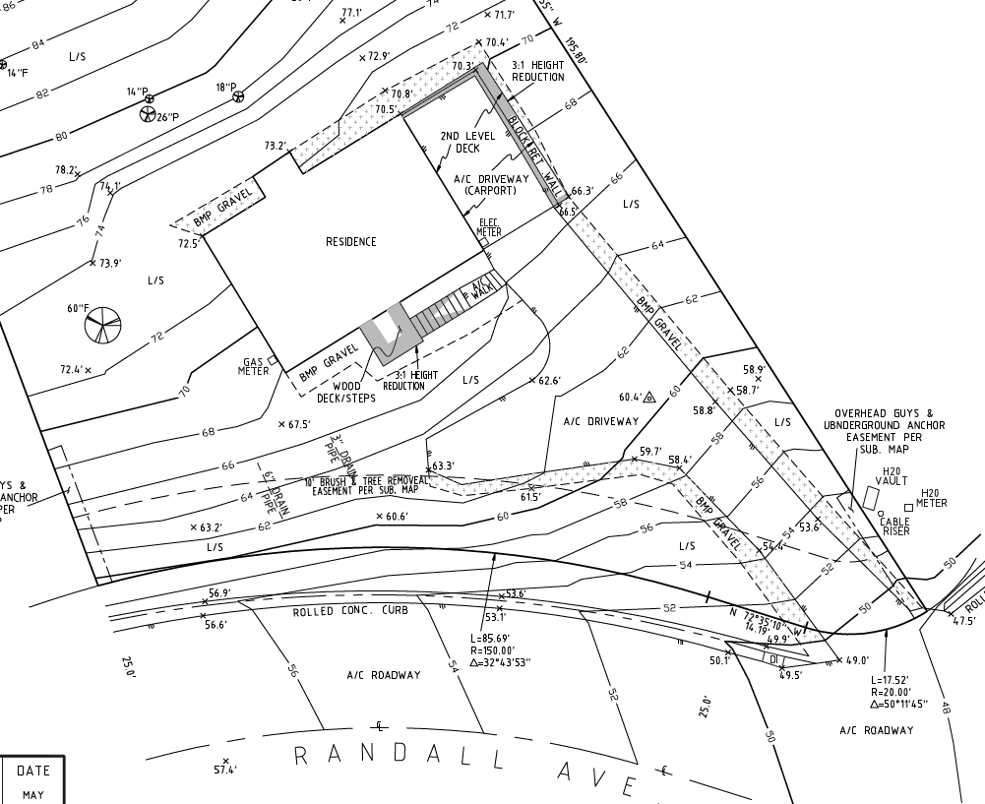
Existing Site Plan

Slide 5
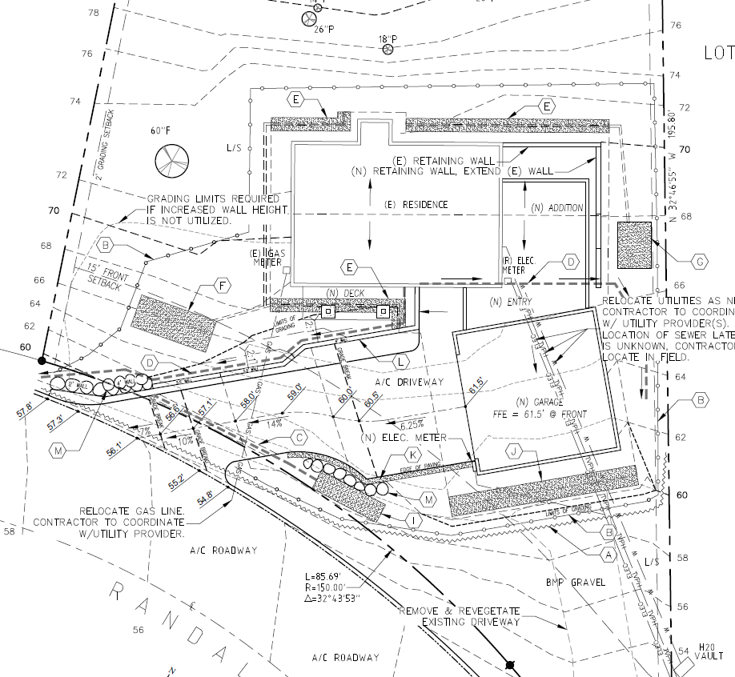
Proposed Grading Plan

Slide 6
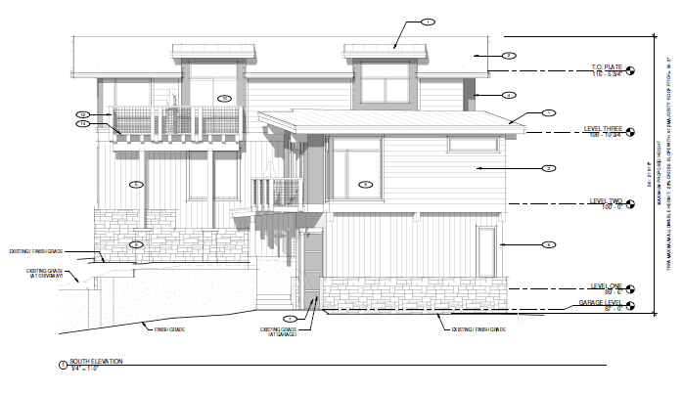
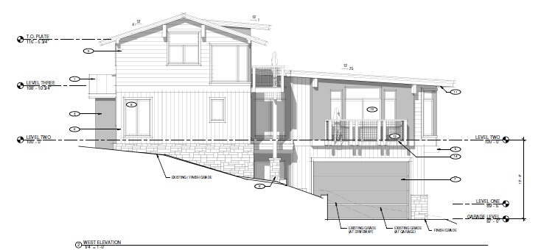
Building Elevations

Slide 7
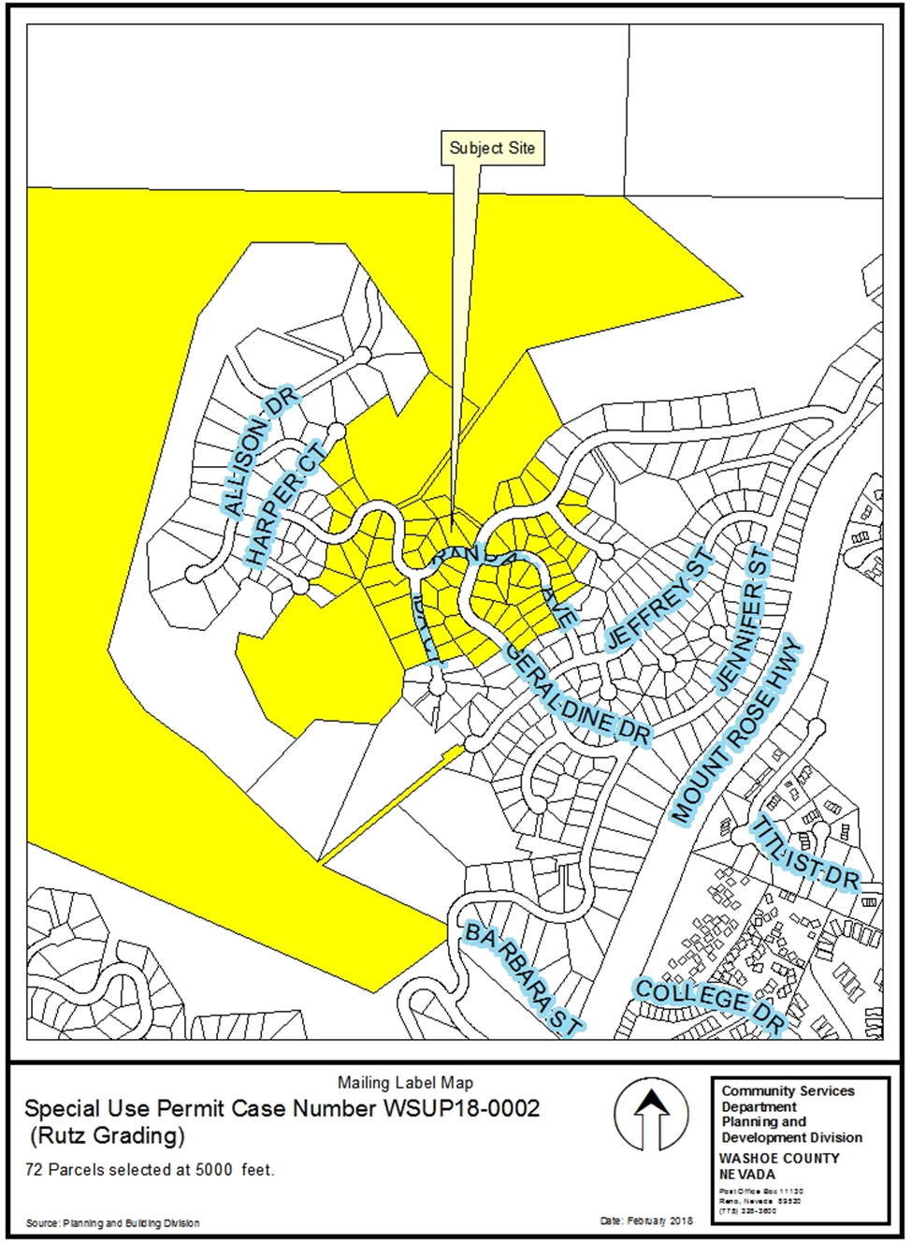
Public Notice and CAB
72 Parcels noticed at 500 foot radius
IV CAB on 3/5/2018
Recommended Approval

Slide 8
Reviewing Agencies
Washoe County Community Service
Planning and Building Division
Engineering and Capital Projects
Nevada State Lands
Washoe County Health District (next slide)
All recommended conditions of approval have been included.

Slide 9
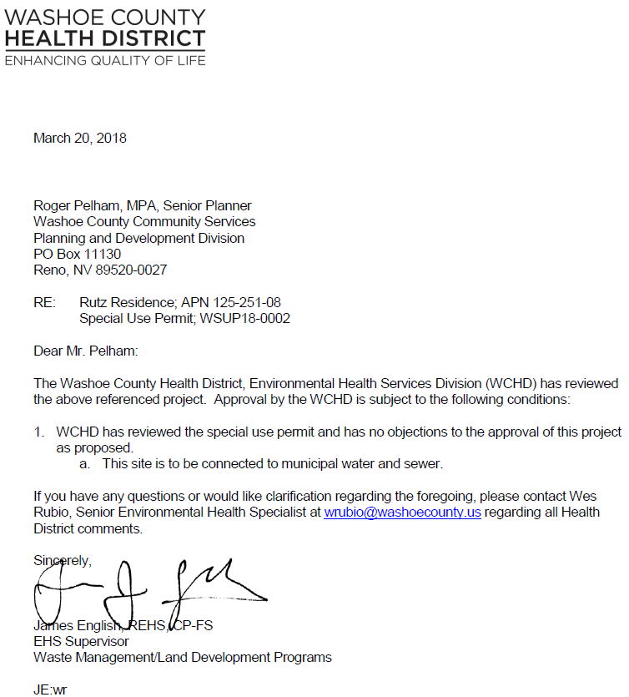

Slide 10
Health Condition
This site is to be connected to municipal water and sewer.

Slide 11
Special Use Permit Findings
Findings and evaluation can be found on page 7 of the staff report.
Staff believes that all findings can be made and recommends approval with conditions.

Slide 12
Possible Motion
I move that, after giving reasoned consideration to the information contained in the staff report and information received during the public hearing, the Washoe County Board of Adjustment approve, with conditions and with the additional condition by the Health District, Special Use Permit Case Number WSUP18-0002 for David and Tammy Rutz, having made all five findings in accordance with Washoe County Code Section 110.810.30

